Slide 1

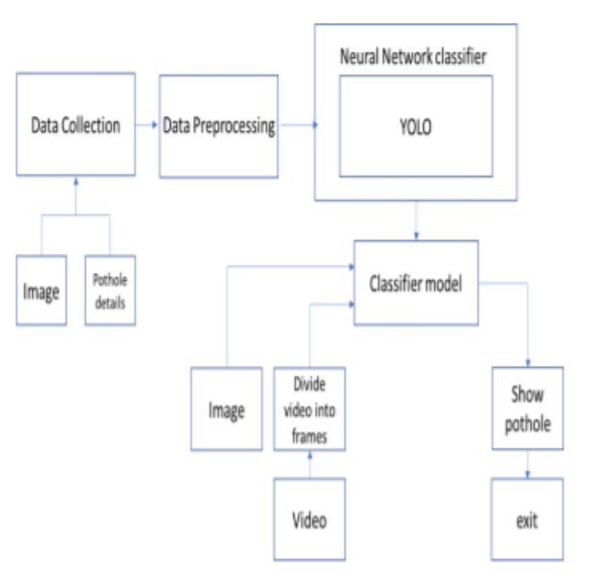
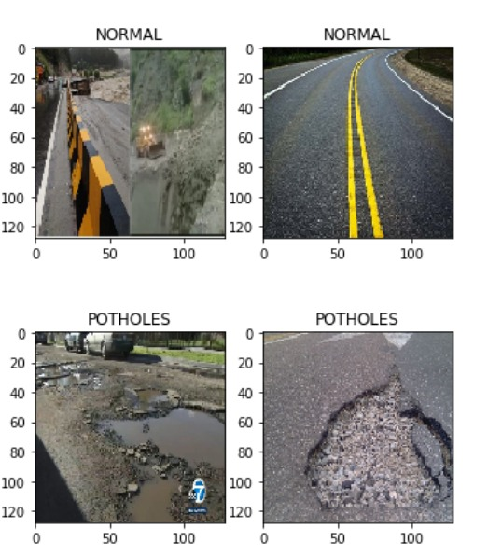

POTHOLE DETECTION SYSTEM USING AI (YOLO)
Prakash Reddy,Teja gurramkonda,Bharat,Sreesanthreddy,Jyothirmai,Teja Kammineni,Thirumala Rao
Advisor: Dr. Sejun Song, University of Missouri – Kansas City
MOTIVATION:
One of the main factors in road accidents and the deterioration of automobiles is the presence of potholes on the roads. There have been a number of ways used, including manual reporting to the authorities, the use of vibration-based sensors, and 3D reconstruction utilizing laser photography. However, there are certain disadvantages to all of these methods, such as expensive setup costs, risk of detection, or lack of night vision. In order to execute augmentation techniques on the data and use convolutional neural networks as a deep learning strategy, our primary aim is to collect a sufficient amount of data that includes photographs of potholes in varied situations and weather.
MOTIVATION:
YOLO, or You Only Look Once, operates through a methodology that involves the division of an input image into a grid, enabling localized object detection. Within each grid cell, the algorithm predicts multiple bounding boxes, each associated with confidence scores reflecting the likelihood of an object's presence. Concurrently, class probabilities for different object categories are determined within these bounding boxes using softmax activation. The algorithm predicts relative coordinates and sizes of the bounding boxes, including the center coordinates (x, y), width, and height. Utilizing intersection over union (IoU), confidence scores are calculated, aiding in assessing the accuracy of the predicted boxes. To refine and streamline the output, non-maximum suppression is employed, eliminating redundant or overlapping predictions.
The final output comprises bounding boxes with corresponding class labels and confidence scores, providing a comprehensive representation of detected objects in the image. During the training phase, YOLO optimizes its parameters based on a labeled dataset, addressing both localization and classification errors to enhance its object detection capabilities. The efficiency of YOLO lies in its ability to perform real-time object detection by processing the entire image in a single pass through the neural network.
CURRENT PROBLEMS WITH POTHOLE
YOLO
Driver safety is significantly improved by effective and proactive treatment of potholes in a complex road environment. Additionally, it is anticipated to help maintain traffic flow and assist to the reduction of traffic accidents. The majority of pothole detection in the past was done by human professionals using eye inspection. It takes a lot of time, money, and effort to physically find potholes.
The major goal of this research is to create a system that can recognize potholes in photographs. Real-time pothole detection is an alternative. A deep learning-based strategy has been used to this. A model built on a YOLO that can distinguish between roads with and without potholes has been created. After using this data to train the model, it can predict with an accuracy of up to 90% if the input image has a pothole or not.
OUR SOLUTION
The suggested approach consists of the following four steps:
Data collecting;
Data preprocessing;
Training a YOLO deep learning model to categorize potholes; and
optimization of the hyperparameters to produce a more effective model .Data collection was the experiment's first phase.
METHODOLOGY
Data Collection and Preprocessing
Photos of potholes and regular images make up the data that we have gathered. After gathering photos of both potholes and smooth surfaces, we pre-processed the dataset of images. The photos were subjected to the following several operations throughout the dataset's pre-processing.
CONCLUSION
Successfully the images were correctly identified with the best accuracy of 90% using pre trained YOLO model.
In future we can connect it to mobile by using GPS tracking and it will be helpful for the passengers to provide live updates of pothole.

